Slide 1

Fast and Accurate
Privacy-Preserving Machine Learning
Qian Lou
louqian@iu.edu
Indiana University Bloomington

Slide 2
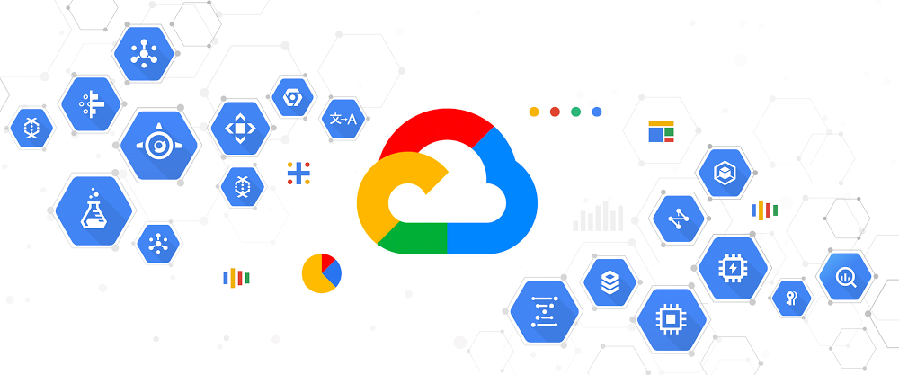
Machine Learning as a Service
Source: Google Cloud Platform

Slide 3
Machine Learning as a Service
Privacy risk
Client’s data privacy matters
Privacy-preserving inference is needed
Multi-Party Computation (MPC)[1] : Large communicational overhead
Differential Privacy [2]: Tradeoff between utility and privacy
Homomorphic Encryption (HE)[3] : Big computational overhead
[1]B. Kreuter-Security’12
[2]M. Abadi-CCS’16
[3]N. Dowlin-ICML’16

Slide 4
Homomorphic Encryption (HE)-enabled Inference
HE-enabled model
- Inefficient homomorphic activations.
+ Offload compute to cloud
+ Preserve data privacy
+ No need to trust the 3rd party like Intel/Google
- long latency (A CIFAR-10 image inference >720s).
- HE-enabled training?
All are optimized by our work
4

Slide 5
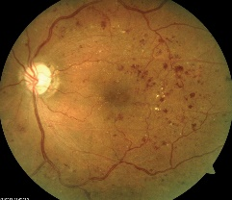
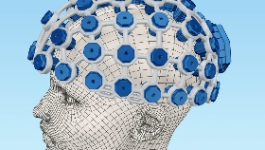
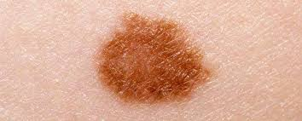
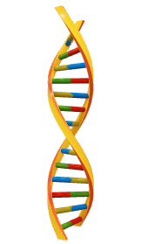
My research: design for private deep learning
Theory & algorithms
Algorithms with network and cryptography optimization for practical private deep learning
[NeurIPS19][CCS20w][ICLR20][NeurIPS20a][NeuIPS20b]][NeurIPS20c][ICLR21]
Tools
SHE
SafeNet
Falcon
[NeurIPS19]
[ICLR21]
[NeurIPS20a]
Applications
[ACM PACT20]
[ASPDAC20]
[NeurIPS20b]
[NeurIPS19]

Slide 6
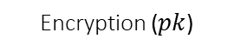
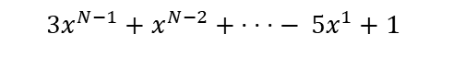
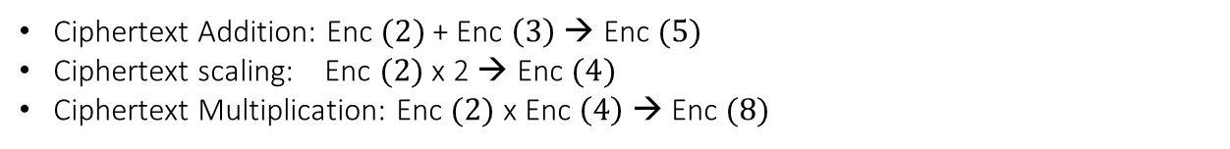
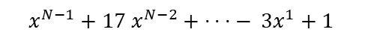
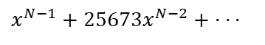
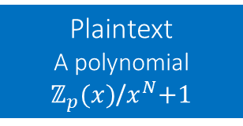

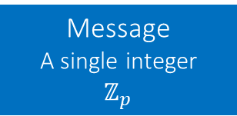
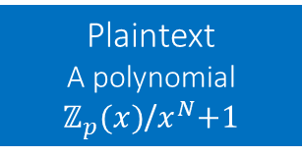
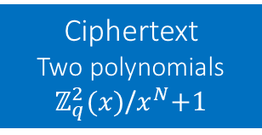

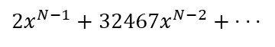

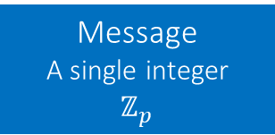
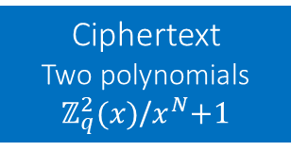
HE operations
Message
A single integer
$$ℤ_{p}$$
Plaintext
A polynomial
$ℤ_{p}(x)$/$x^{N}$+1
Encryption ($pk$)
Ciphertext
Two polynomials
$ℤ_{q}^{2}(x)$/$x^{N}$+1
Encoding
$$2$$
$x^{N−1}+17$ $x^{N−2}+\text{·}$ · · $−$ ${3x}^{1}+1$
$x^{N−1}+25673x^{N−2}+\text{·}$ · ·
Ciphertext
Operations
Message
A single integer
$$ℤ_{p}$$
Decoding
Plaintext
A polynomial
$ℤ_{p}(x)$/$x^{N}$+1
Ciphertext
Two polynomials
$ℤ_{q}^{2}(x)$/$x^{N}$+1
Decryption ($sk$)
$$2$$
${3x}^{N−1}+$ $x^{N−2}+\text{·}$ · · $−$ ${5x}^{1}+1$
${2x}^{N−1}+32467x^{N−2}+\text{·}$ · ·
Ciphertext operations
Ciphertext Addition: Enc $(2)$+ Enc $\left(3\right)$ → Enc $(5)$
Ciphertext scaling: Enc $(2)$ x 2 → Enc $(4)$
Ciphertext Multiplication: Enc $(2)$ x Enc $\left(4\right)$ → Enc $(8)$

Slide 7
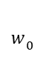
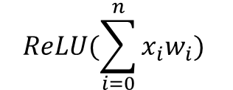
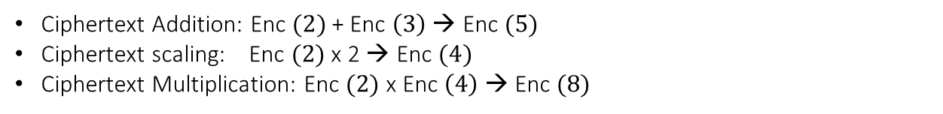
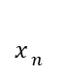
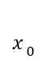
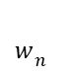
HE-enabled Neural Networks
Ciphertext operations
Ciphertext Addition: Enc $(2)$+ Enc $\left(3\right)$ → Enc $(5)$
Ciphertext scaling: Enc $(2)$ x 2 → Enc $(4)$
Ciphertext Multiplication: Enc $(2)$ x Enc $\left(4\right)$ → Enc $(8)$
HE-enabled neural networks
$$w_{ n}$$
$$w_{ 0}$$
$$x_{ 0}$$
$$x_{ n}$$
…
$$ReLU(\sum_{i=0}^{n}{x_{i}w_{i})}$$
Ciphertext scaling: Enc $(x_{i})$ x $w_{i}$ → Enc $(x_{i}w_{i})$
Ciphertext Addition: Enc $(x_{i}w_{i})$+ Enc $\left(x_{i+1}w_{i+1}\right)$ → Enc $(x_{i}w_{i}+x_{i+1}w_{i+1})$
How to support non-linear activations?

Slide 8
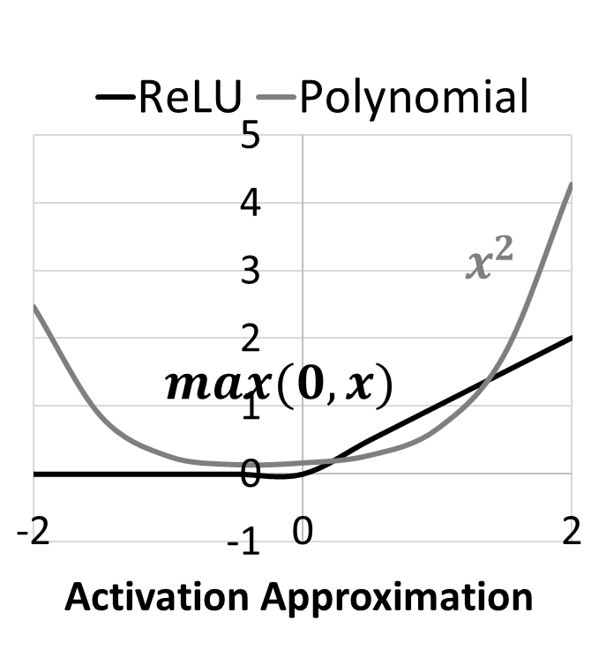
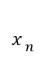
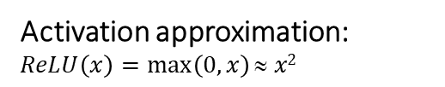
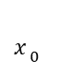
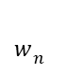
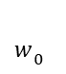
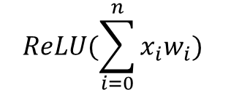
Previous works: approximation
$$w_{ n}$$
$$w_{ 0}$$
$$x_{ 0}$$
$$x_{ n}$$
…
$$ReLU(\sum_{i=0}^{n}{x_{i}w_{i})}$$
Ciphertext scaling: Enc $(x_{i})$ x $w_{i}$ → Enc $(x_{i}w_{i})$
Ciphertext Addition: Enc $(x_{i}w_{i})$+ Enc $\left(x_{i+1}w_{i+1}\right)$ → Enc $(x_{i}w_{i}+x_{i+1}w_{i+1})$
How to support non-linear activations?
Activation approximation:
$$ReLU\left(x\right)=\max\left(0,x\right)≈ x2$$
CryptoNets [Nathan+, ICML’16]
CHET [Datha+, PLDI’19]
Faster CryptoNets [Edward+, arxiv’19]
LoLa [Alon+, ICML’19]
DiNN [Florian+, Security’17]
TAPAS [Amartya+, ICML’18]
Large approximation error
Difficult training

Slide 9
Problem: Inefficient HE activations
Error Rate (%)
Execution Time (s)
Approximated polynomial degree D
Increase polynomial degree D → smaller inference error
Increase polynomial degree D → exponentially increased latency
9

Slide 10
Solution: TFHE-based HE activations
Prior HE schemes:
BGV, BFV, FV-RNS and HEAAN
Enc(fixed point number), e.g., Enc(10)
TFHE:
Enc(binaries), e.g., 10 = 1010₂, Enc(1), Enc(0), Enc(1), Enc(0)
Enc(1) AND Enc(0) = Enc(0)
Enc(1) OR Enc(1) = Enc(1)
0
R
[
2
]
X
[
2
]
R
[
1
]
X
[
1
]
X
[
0
]
R
[
0
]
3-bit ReLU
10

Slide 11
TFHE Problem: Slow Multiply-accumulate
Prior HE schemes:
BGV, BFV, FV-RNS and HEAAN
10 x 11 = 110 1 operation!
TFHE:
1 0 1 0
X 1 0 1 1
1 0 1 0
1 0 1 0
Error Rate (%)
Execution Time (s)
0 0 0 0
1 0 1 0
1 1 0 1 1 1 0
>16 operations!
11

Slide 12
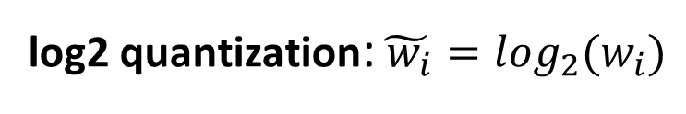
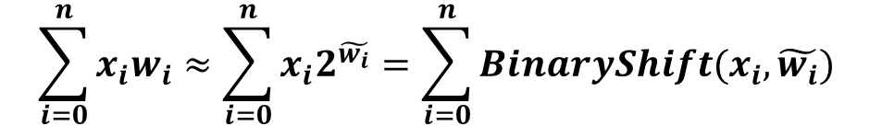
Solution: Log2 quantization
log2 quantization:${{\tilde{ w_{i}}=log}_{2}(w}_{i})$
$$\sum_{i=0}^{n}{x_{i}w_{i}≈\sum_{i=0}^{n}{x_{i}2^{\tilde{w_{i}}}}}=\sum_{i=0}^{n}{{BinaryShift(x}_{i}, \tilde{w_{i}})}$$
e.g., 10 * 0.6 ≈ 1 0 1 0₂ * 2⁻¹ = 1 0 1₂
user
server
1
1
1
1
1
0
1
0
C
C
C
C
C
C
C
C
7
6
5
4
3
2
1
0
1
1
1
1
1
1
1
0
C
C
C
C
C
C
C
C
7
7
7
6
5
4
3
2

Slide 13
TFHE-log2-quantized neural networks
Execution Time (s)
Error Rate (%)
TFHE→ smaller inference error
Log2 quantize→ lower latency

Slide 14
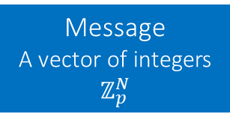
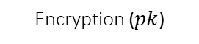
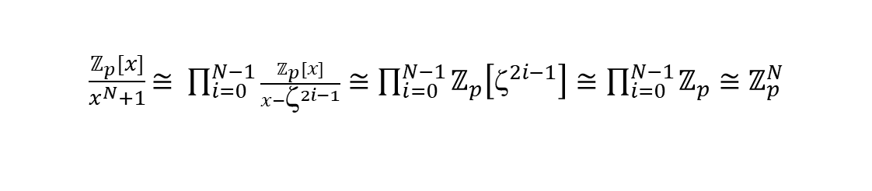
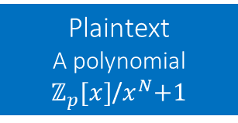
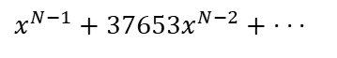
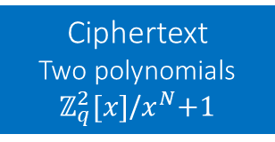
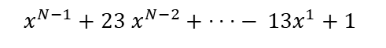
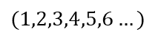
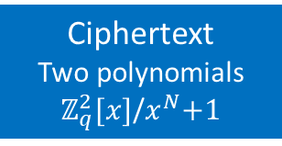
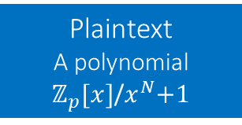
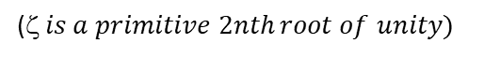
Low-latency Batching Operations
Before Batching:
Message
A single integer
$$ℤ_{p}$$
Plaintext
A polynomial
$ℤ_{p}[x]$/$x^{N}$+1
Encryption ($pk$)
Ciphertext
Two polynomials
$ℤ_{q}^{2}[x]$/$x^{N}$+1
Encoding
$$2$$
$x^{N−1}+17$ $x^{N−2}+\text{·}$ · · $−$ ${3x}^{1}+1$
$x^{N−1}+25673x^{N−2}+\text{·}$ · ·
Batching:
$$x^{N}+1=\left(x−ζ\right)\left(x−ζ^{3}\right)…\left(x−ζ^{2N−1}\right)\left(mod p\right)$$
($ is a primitive 2nth root of unity)$
$\frac{ℤ_{p}[x]}{x^{N}+1}$ $≅ \prod_{i=0}^{N−1}{\frac{ℤ_{p}[x]}{x−ζ^{2i−1}}}≅\prod_{i=0}^{N−1}{ℤ_{p}\left[ζ^{2i−1}\right]≅\prod_{i=0}^{N−1}{ℤ_{p}≅}}$ $ℤ_{p}^{N}$
Plaintext space
A vector of integers
After Batching:
Message
A vector of integers
$$ℤ_{p}^{N}$$
Plaintext
A polynomial
$ℤ_{p}[x]$/$x^{N}$+1
Encryption ($pk$)
Ciphertext
Two polynomials
$ℤ_{q}^{2}[x]$/$x^{N}$+1
Batching
$$(1,2,3,4,5,6…)$$
$x^{N−1}+23$ $x^{N−2}+\text{·}$ · · $−$ $1{3x}^{1}+1$
$x^{N−1}+37653x^{N−2}+\text{·}$ · ·
14

Slide 15

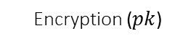
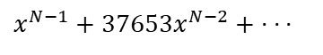
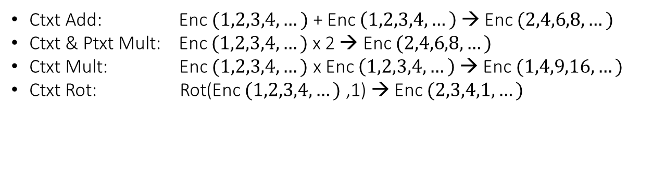

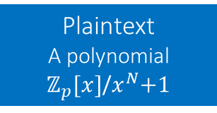
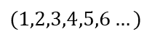
Low-latency Batching Operations
After Batching:
Message
A vector of integers
$$ℤ_{p}^{N}$$
Plaintext
A polynomial
$ℤ_{p}[x]$/$x^{N}$+1
Encryption ($pk$)
Ciphertext
Two polynomials
$ℤ_{q}^{2}[x]$/$x^{N}$+1
Batching
$$(1,2,3,4,5,6…)$$
$x^{N−1}+23$ $x^{N−2}+\text{·}$ · · $−$ $1{3x}^{1}+1$
$x^{N−1}+37653x^{N−2}+\text{·}$ · ·
15
Ctxt Add: Enc $(1,2,3,4,…)$+ Enc $\left(1,2,3,4,…\right)$ → Enc $(2,4,6,8,…)$
Ctxt & Ptxt Mult: Enc $(1,2,3,4,…)$ x 2 → Enc $(2,4,6,8,…)$
Ctxt Mult: Enc $(1,2,3,4,…)$ x Enc $\left(1,2,3,4,…\right)$ → Enc $(1,4,9,16,…)$
Ctxt Rot: Rot(Enc $(1,2,3,4,…)$ ,1) → Enc $(2,3,4,1,…)$
Batching brings ${10}^{3}$ X ${\sim 10}^{4}$ X speedup (amortized) and better be used.
Batching brings expensive rotations to perform matrix-vector multiplication.
15

Slide 16
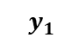
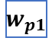




































Solution: Reducing rotation numbers using FFT
$$y$$
$$W$$
$$x$$
$${ w}_{ij}$$
$${ x}_{j}$$
$${ y}_{1}$$
$$…$$
$${ w}_{11}$$
$${ w}_{1q}$$
$${ x}_{1}$$
$$…$$
-1.39
0.06
1.56
0.36
0.36
0.57
$$…$$
$$⋅$$
0.36
-1.39
0.06
$$⋅$$
$${ y}_{i}$$
$$=$$
$$…$$
$$…$$
1.56
0.43
$$=$$
4.86
$${ w}_{ij}$$
$${ x}_{i}$$
$$…$$
1.56
0.36
-1.39
0.06
-0.12
1.09
$$…$$
$${ y}_{p}$$
$$…$$
0.06
1.56
0.36
-1.39
3.42
-4.10
$${ w}_{p1}$$
$${ w}_{pq}$$
$${ x}_{p}$$
$$yi=\sum_{i=1}^{q}{IFFT(FFT\left(wij\right)×FFT(xj)))}$$
(Offline$)$
$${ w}_{ij}$$
$$FFT$$
-1.39
0.06
1.56
0.36
$$Element wise$$
Multiplication
$$−$$
$$IFFT$$
$$ReLU$$
$${ x}_{j}$$
$$FFT$$
0.36
0.43
-0.12
3.42

Slide 17

















Solution: homomorphic spectral operations
$$client$$
$$server$$
$$\left[x0\right]\text{=}Enc(x0,pk)$$
$$\left[x0\right]$$
$$\left[u1\right]\text{=}HConv([x0],W0)$$
$$\left[y1\right]\text{=}HReLU([u1])$$
$$LoLa$$
$$\left[u2\right]\text{=}HConv([y1],W0)$$
$$replaced$$
$$\left[\hat{y_{1}}\right]\text{=}HDFT([y1],k_{1})$$
$$Ours$$
$$\left[\hat{u_{2}}\right]\text{=}HSConv(\hat{{[y}_{1}]},\hat{C_{1}})$$
$$\left[u2\right]\text{=}HIDFT([\hat{u_{2}}])$$
$$\left[un\right]$$
$$…$$
$$u_{n}\text{=}Dec([un],sk)$$
$$\left[un\right]\text{=}HFC([u_{n−1}],W_{n−1})$$
$$Workflow of HERB.$$
Replace LoLa spatial operations into our spectral operations (few rotations).
Propose efficient HDFT and HIDFT using block-circulant matrices.
LoLa: [Brutzkus-ICML’19]

Slide 18
Experiments and Results
Schemes | MNIST |  | CIFAR-10
 | Latency | Accuracy | Latency | Accuracy
Previous [1] | 2.2 seconds | 98.95% | 730 seconds | 76.5%
Ours | 1.2 seconds | 98.95% | 107 seconds | 76.5%
 | 45.5% ↑ | - | 6.8x ↑ | -
LoLa: [Brutzkus-ICML’19]

Slide 19






Training on Encrypted Data
Medical Diagnosis Apps
Encrypted Model
Clients
Server
Sensitive data
AI platform
+ Offload compute to cloud
+ Preserve data privacy
+ No need to trust 3rd party like Intel/Google
- long latency overhead by encrypted computation
- Inefficient activation (BGV homomorphic encryption)
All are improved by our work Glyph

Slide 20
Problem: Slow operations on ciphertexts
Operation | BGV latency (s) | TFHE latency (s)
Ciphertext-Ciphertext mult: MultCC | 0.012 | 2.121
Ciphertext-Plaintext mult: MultCP | 0.001 | 0.092
Could we reduce the operations on ciphertexts (MultCC)?

Slide 21
Solution: Partially Training on Encrypted Data
1. Pretrain our model on a public dataset
2. Discard the last fully-connected layers and transfer the first convolution layers
3. Train on encrypted data and only update encrypted weights within the added FC layers
Cheap multiplication
(ciphertext and plaintext)
Few expensive multiplication
(ciphertext and ciphertext)

Slide 22
Problem: Weakness of each HE scheme
Operation | BGV latency (s) | TFHE latency (s)
Ciphertext activation: ActCC | 307.9 | 3.328
Ciphertext-Ciphertext mult: MultCC | 0.012 | 2.121
Ciphertext-Plaintext mult: MultCP | 0.001 | 0.092
Ciphertext-Ciphertext add: AddCC | 0.002 | 0.312
Could we use BGV for linear operations and use TFHE for non-linear operations?

Slide 23
Solution: Training using multiple HE schemes
Use BGV scheme to implement linear ops. ,i.e., Convolutions
Switch BGV scheme to TFHE scheme
Use TFHE scheme to implement activations, i.e., ReLU.
Notes:
Motivation

Slide 24
Experiments and Results
Schemes | MNIST |  | Skin-cancer
 | One-batch latency | Accuracy | One-batch latency | Accuracy
Priors [1] | 2.3 hours | 97.8% | 2.4 hours | 70.2%
Ours | 0.04 hours | 98.6% | 0.08 hours | 73.2%
 | 57.5x ↑ | 1.2% ↑ | 30x ↑ | 3.2 ↑
[Karthik CVPRW’19]

Slide 25

Future works

Slide 26
Fast and Accurate
Privacy-Preserving Machine Learning
Qian Lou
louqian@iu.edu
Indiana University Bloomington

